Slide 1
TI MCU with graphics interface - PRU IO – LCD interface
Re 01 – 09/01/2025

Slide 2
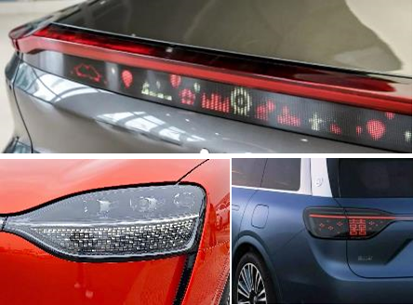
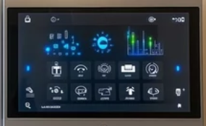
AM261 – uLED/display driver
Target application
Automotive lighting
Industrial displays
Output Interfaces:
Parallel LCD/RGB24
Display UART (25 MHz)
CCSI – continuous clock SPI
Compute: (interface + image proc)
2 x 400 MHz R5F
4 x 200 MHz PRU
Input Interface:
CAN_FD
Ethernet (10/100/1G TX/T1)
Serial/parallel LVDS RGB format
Robustness:
ASIL-B
Cyber security
AM261
Ethernet
PRU-ICSS0 – 200 MHZ
2
CPSW
Ethernet
R5FSS – 400 MHZ
48k RAM
Parallel RGB8 –
DMD/LCD (XVGA)
R5F0 –
16k D$
16k I$
256k TCM
R5F1 –
16k D$
16k I$
256k TCM
PRU0
rx dma
CAN_FD
PRU1
Display UART
(20 MHz)
2
CAN_FD
INTC
TMU
TMU
VIM
VIM
PRU-ICSS1 – 200 MHz
48k RAM
CCSI – continuous clock LP5981Q (LED matrix)
1.5 MB SRAM
PRU0
rx dma
OSPI
EDMA
INTC
PRU1
Serial/parallel LVDS – video input

Slide 3
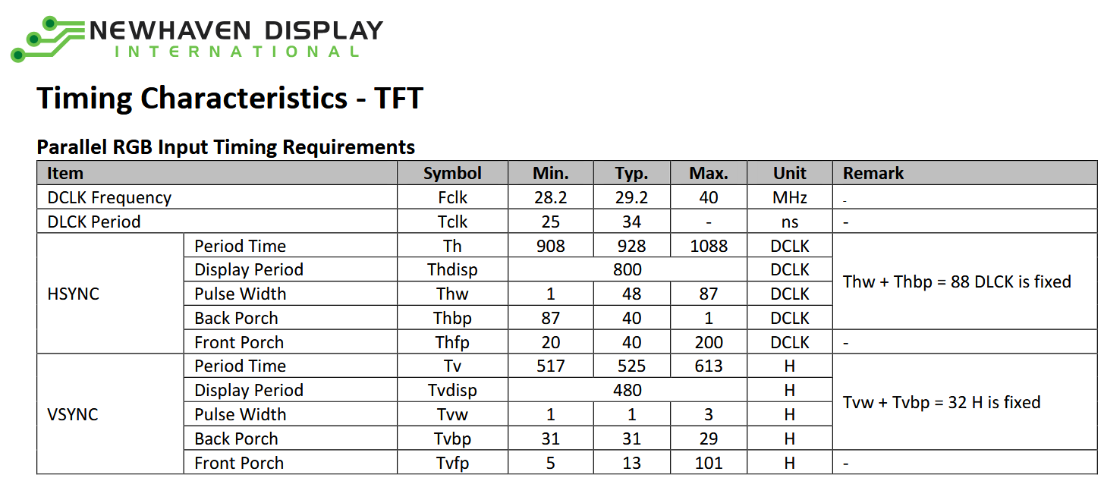
LCD interface with parallel RGB24
Example: NHD-4.3-800480CF-ASXP-CTP (800 x 480 @ 60 Hz, 24 bpp color)
Timing:

Slide 4
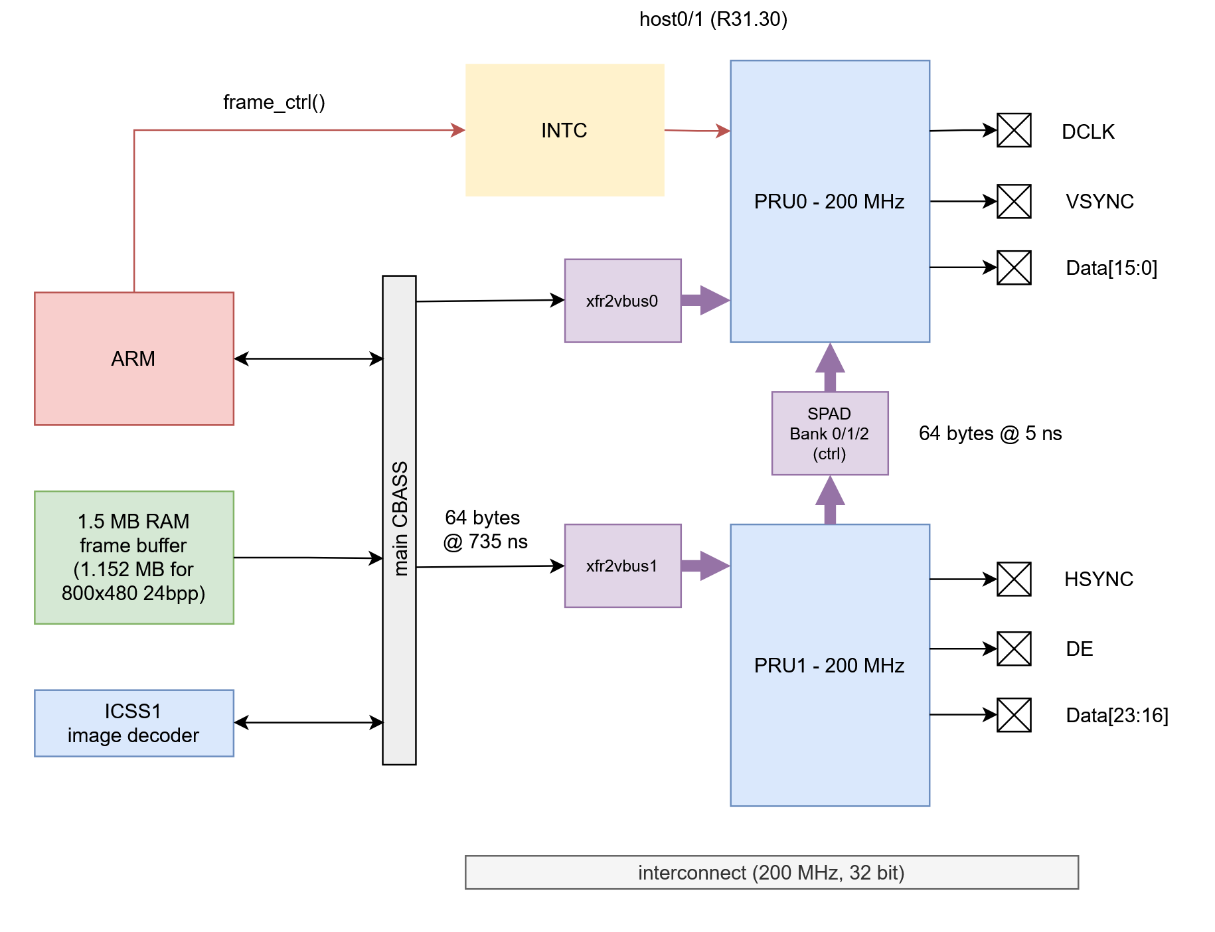
PRU architecture for RGB24 interface
Frame Buffer
800 x 480 x 24 bits = 1.152 Mbytes
On-chip SRAM, < 100 ns read latency
DMA
xfr2vbus read DMA in 64 byte auto increment mode, reads every 735 ns
Direct broadside read into PRU register
Non blocking single cycle read for 64 bytes
Output Interface
2 x PRU @ 200 MHz in direct GPO mode
30 PRU GPOs split across two PRO cores
PRU cores run in sync – same clock cycle
LUT for blue color bit mapping (EVM limitation)
Shift for green color bit mapping (EVM limitation)
Output Timing:
35 ns DCLK based on 5 ns PRU cycle time – 7 cycles
HSYNC: 40 + 800 + 40 + 48 DCLK
VSYNC: 31 + 480 +13 +1 HSYNC
10 ns setup and hold time (8 ns in LCD spec)

Slide 5
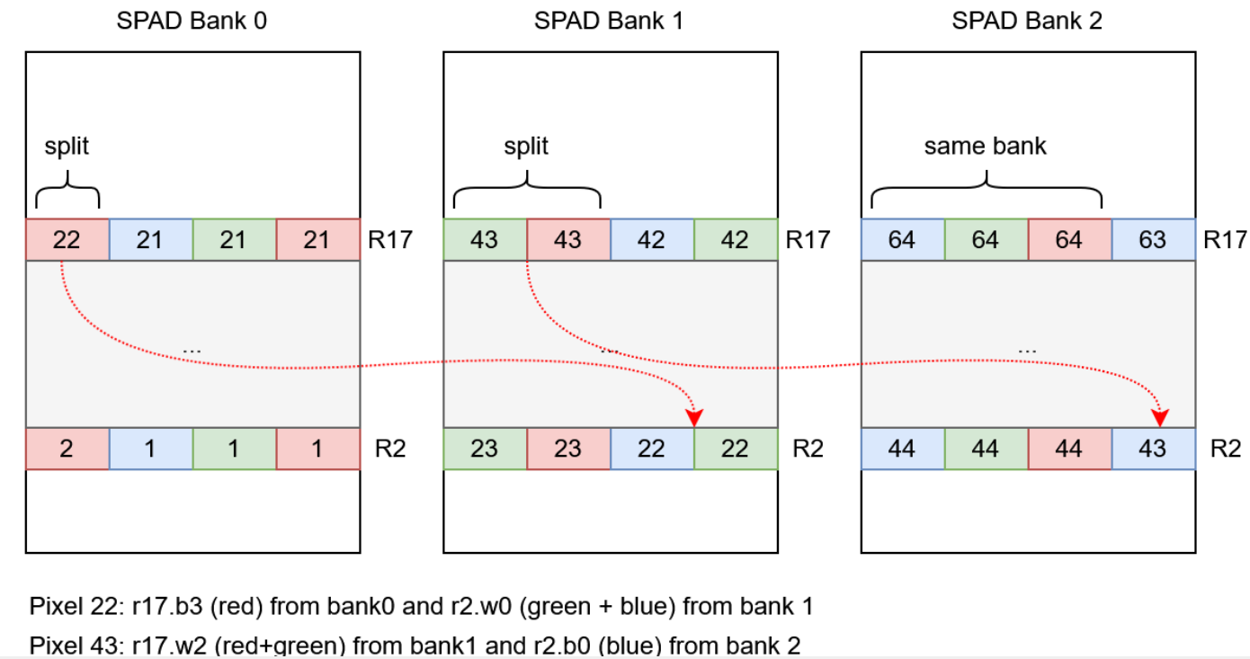
Line size vs DMA transfer size alignment
One Line is stored in sequential memory location: 800 pixel + 24 bit = 1200 bytes.
DMA from frame buffer to register bank is 64 bytes at a time which is not and integer multiple for pixels and line size.
First DMA has 22 pixel for red color and 21 pixel for green and blue color. Pixel 22 is split into two dma transfers
800 pixel line ends at a half 64 byte DMA
Macros for sending even and odd line which are repeated 240 time -> 480 lines.

Slide 6
Pin Mapping with AM243x Launchpad
Function | PRU0 |  | LP
R0 | 0 |  | BP.33
R1 | 1 |  | BP.32
R2 | 2 |  | BP.31
R3 | 3 |  | BP.19
R4 | 4 |  | BP.17
R5 | 5 |  | BP.13
R6 | 6 |  | BP.48
R7 | 7 |  | BP.44
CLK | 8 |  | BP.51
G0 | 11 |  | BP.43
G1 | 12 |  | BP.05
G2 | 13 |  | BP.15
G3 | 14 |  | BP.14
G4 | 15 |  | BP.12
G5 | 16 |  | BP.07
G6 | 17 |  | BP.18
G7 | 18 |  | BP.8
DE | 19 |  | BP.45
Function | PRU1 |  | LP
B0 | 0 |  | BP.11
B1 | 1 |  | BP.67
B2 | 2 |  | BP.68
B3 | 6 |  | BP.69
B4 | 11 |  | BP.70
B5 | 12 |  | BP.72
B6 | 13 |  | BP.71
B7 | 15 |  | BP.59
HSYNC | 16 |  | BP.57
Function | GPIO |  | LP
VSYNC | PRG0_PWM2_A0 |  | BP.40
DISP | GPIO1_41 |  | BP.51
Red Data: continuous bits and byte aligned
Green Data: continuous bits no alignment
Blue Data: no bit and no byte alignment
DE: PRU0 GPO as critical setup and hold time
DCLK: PRU0 GPO as critical setup and hold time
VSYNC: low latency PWM in init mode
HSYNC: PRU1 GPO
DSIP: system GPIO
Note: dedicated/customer hardware should use color bits bit aligned and byte aligned to free up PRU cycles for LUT and shift operation!

Slide 7
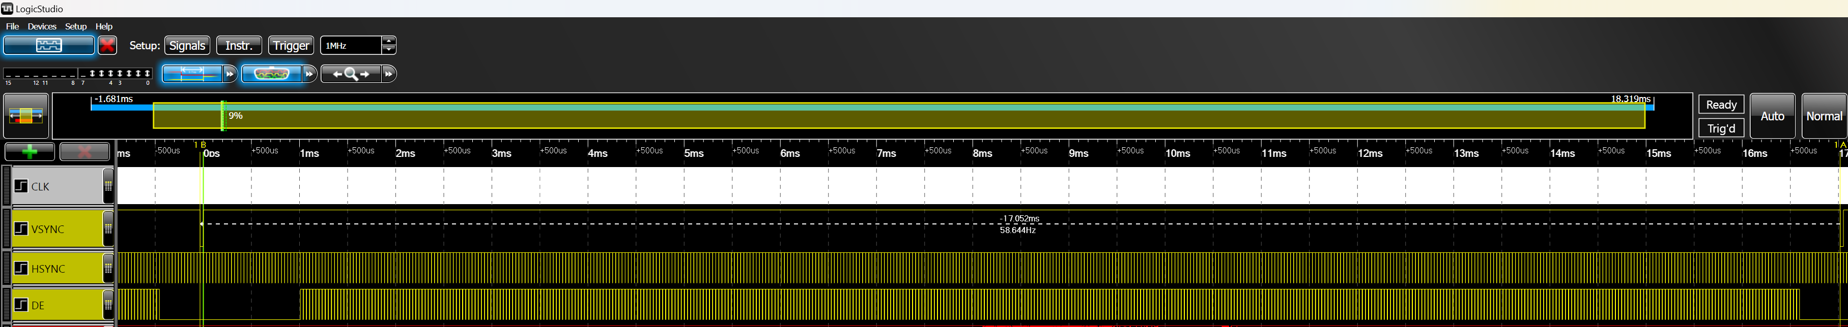
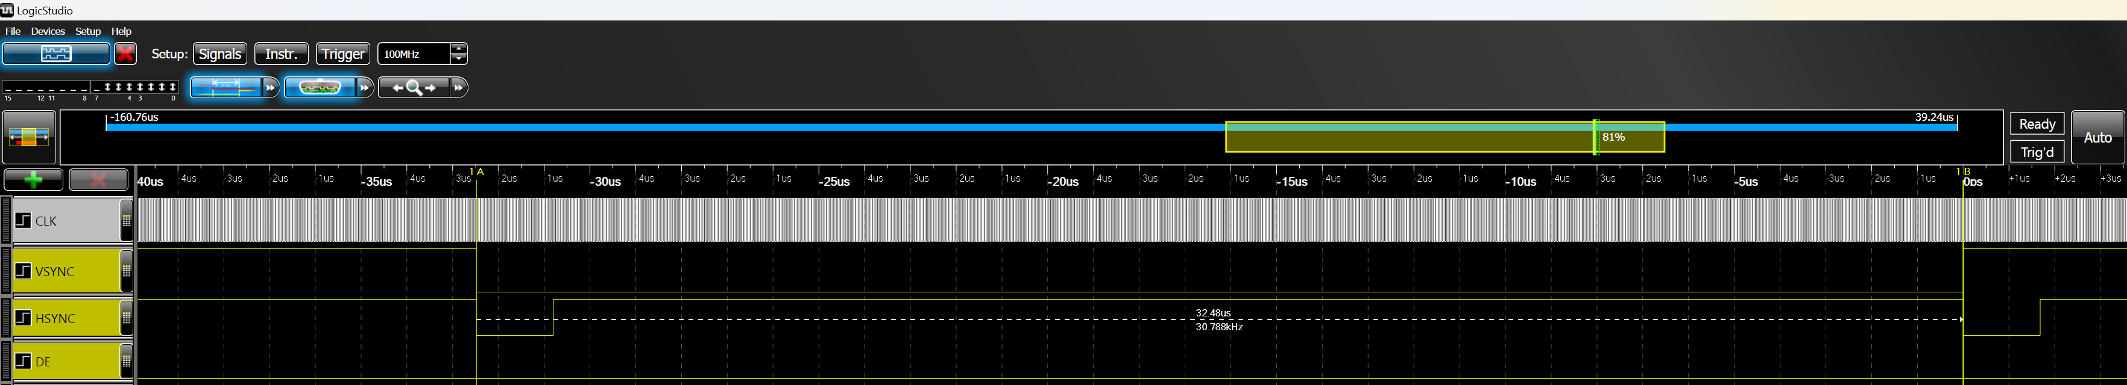
Timing from PRU – RGB24 interface (VSYNC/HSYNC)
VSYNC period: 17.052 ms = 928 * 525 * 35 ns
HSYNC period: 32.480 us = 928 * 35 ns

Slide 8
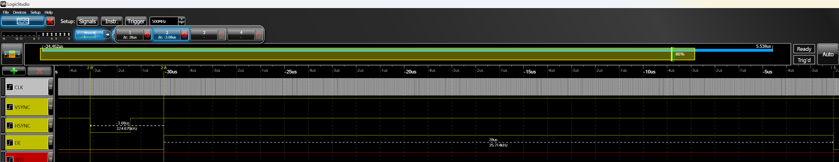
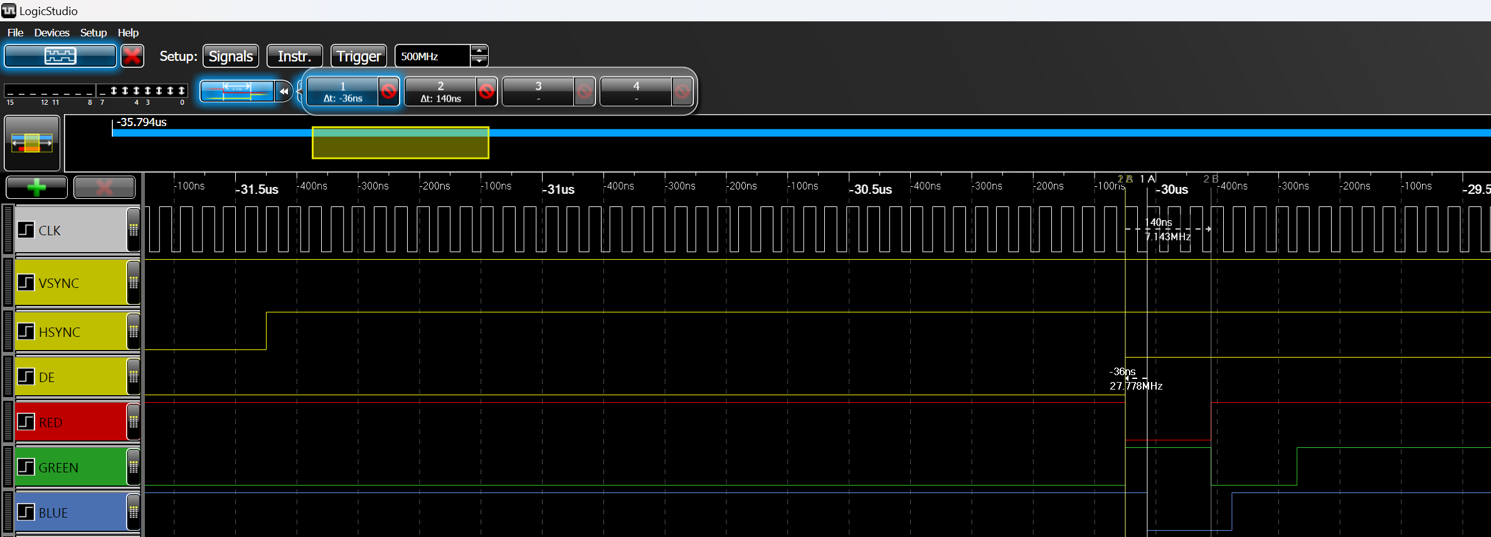
Timing from PRU – RGB24 interface (DCLK/DE/RGB)
HSYNC BACK PORCH + SYNC: 3.08 us = (48 + 40) * 35 ns DE: 28.0 us = 800 * 35 ns
DCLK period: 35 ns (140 ns for 4 x DCLK)
DE setup time: 20 ns
DE hold time: 15 ns

Slide 9
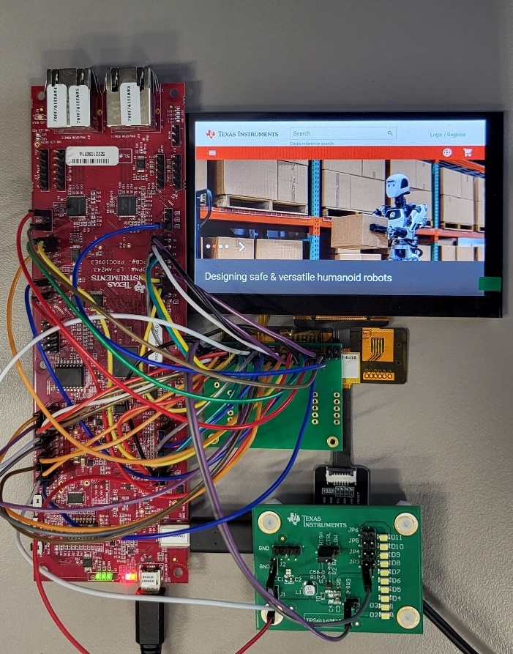
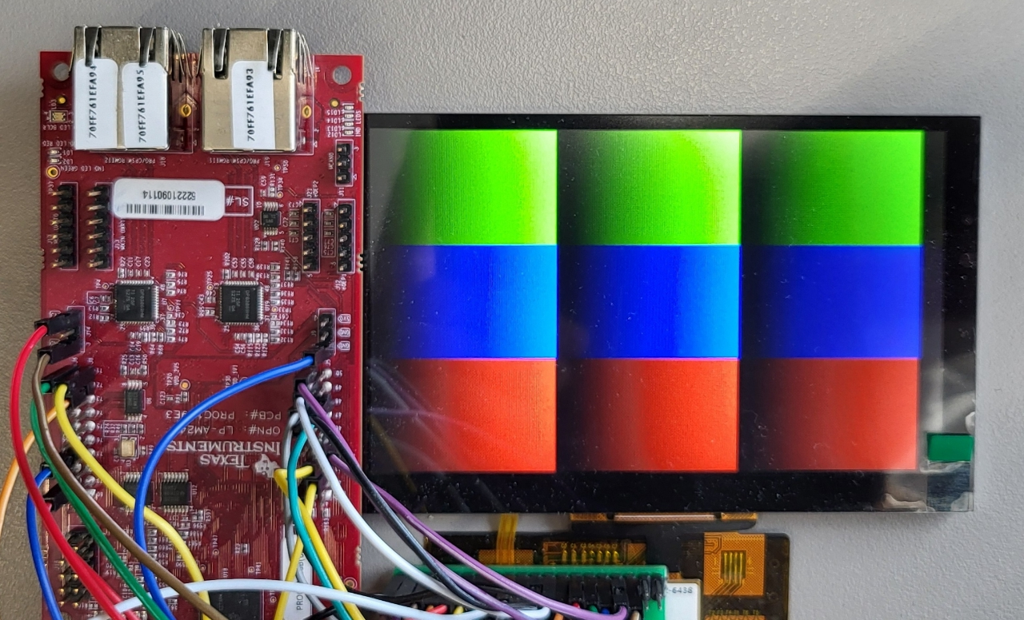
Demo (ICSS_M IP with 200 MHz)
CCS Project with ARM driver and PRU firmware
Image download via CCS memory load
Test image generation with RTU_PRU (used to detect correct color mapping)
Optional diming using PWM signal to back-light control
AM243 LP
NHD-4.3-800480CF
-ASXP-CTP
(800 x 480, RGB24)
I2C Capacitive
Touch interface
TPS61169 EVM
40 mA backlight
Controller
(R5 = 5.1 Ohm)

Slide 10
Customization and Boundaries
AM261/AM263 (ICSS_M IP@200 MHz)
Max DCLK = 30 ns – 6 cycles (800 x 600 @ 60fps)
DCLK period 5ns steps: 30ns , 35 ns, 40 ns, ….
Max resolution: 800 x 600 @ 24 bpp = 1.44 Mbytes SRAM
Customization Guideline:
Understand resolution, frame rata and colors
Map to DCLK and memory boundaries of given device.
Optional LVDS conversion with external bridge device.
AM243/AM64 (ICSS_G IP @ 333 MHz)
MAX DCLK = 18 ns – 6 cycles (1280 x 720 @ 60 fps)
DCLK period in 3/3.3/4/4.14/5 ns steps (various PRU clocks)
Max resolution: 1280 x 720 @ 16 bpp = 1.84 Mbytes SRAM more colors and frame buffers through external RAM.

